Slide 1

Deep Conditional Text to Image Generation
Team: Unnamed
Zeeshan Khan (2021701029)
K. N. Amruth Sagar(2021701013)
Seshadri Mazumder(2021801002)
Course Name : Computer Vision
Course ID : CS7.505
Instructors : Prof. Anoop Namboodiri
Assigned TA : Avinash Prabhu
Project Link : CV Project

Slide 2
Index
Sl No | Topic | Sl No | Topic
1. | Introduction | 6. | Data Preprocessing
2. | Problem Statement | 7. | Generator & Discriminator Models
3. | Methodology | 8. | Losses
4. | Datasets | 9. | Qualitative Evaluation
5. | Pipeline | 10. | References

Slide 3
Introduction
Generation of images from the give text description is a multimodal problem, where there are two tasks involved.
The first one is to ensure that all the characteristics of the object that we want to generate and the attributes of the object we want are properly encoded into some form of textual representation.
The second task is learn a mapping function which uses this encoded vector with information about object to generate an image. Advances in deep learning techniques has provided ways to tackle this problem as we possess models which provide good feature representation and also are capable of generating images from noise. Still, this problem far from completely solved.

Slide 4
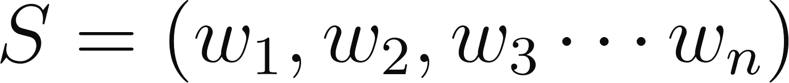
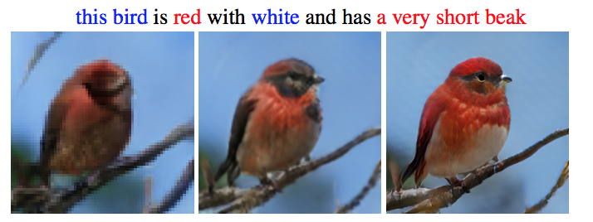
Problem Statement
Given a single-sentence human-written description
learn a text feature representation that captures all the visual features present in the sentence and use these features to synthesize a compelling image that a human might mistake for real.

Slide 5
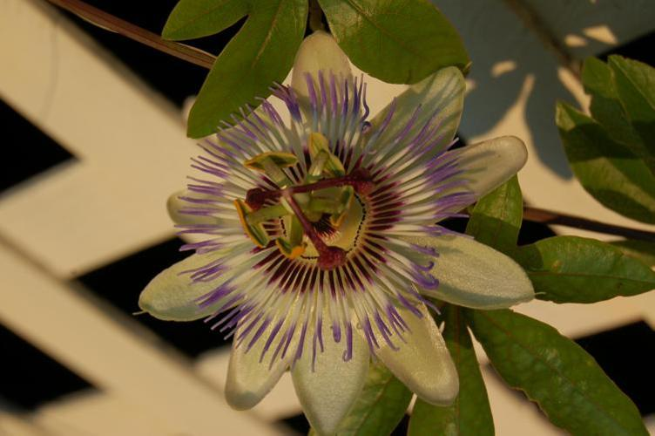
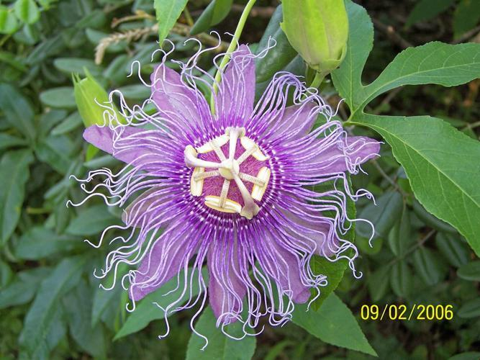
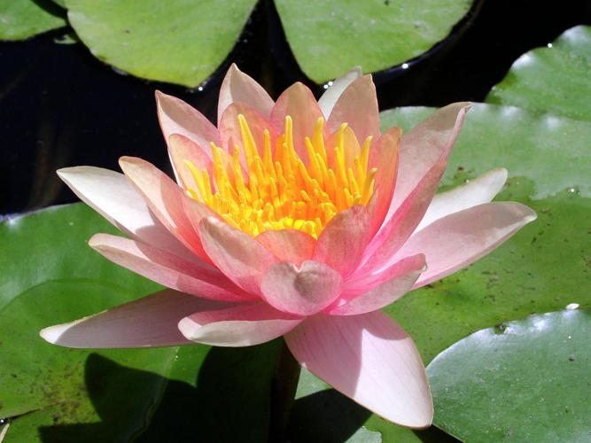
Datasets
We have used the 102 Category Flower dataset for the task.
Stats:
Images per category of flower : images per category
No of images per category : 40 to 258
No of description per image : 10

Slide 6
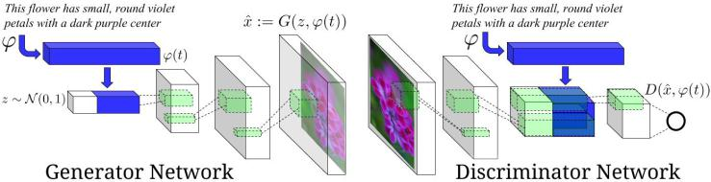
Pipeline
Text to image DC-GAN

Slide 7
Data Preprocessing
All the images were resized to 64*64.
For each image, 10 textual description were selected.
Then, we get the embeddings of the textual descriptions using BERT, and they are saved separately.
BERT
Sentence
384 dimensional Embedding

Slide 8
Generator and discriminator Model Architecture
Generator
generator
Discriminator
discriminator
Embedding+noise is fed into generator, which generates an image
In discriminator, we again concatenate the embedding of the textual description in the last layers.
This is to condition the output of the generator on the input sentence.

Slide 9
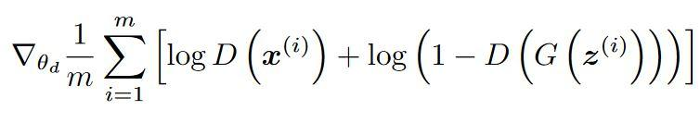
Loss
KL Divergence
Kullback-Leibler Divergence (KL divergence), or relative entropy, quantify the difference between probability distributions for a given random variable.
LPIPS
Learned Perceptual Image Patch Similarity (LPIPS) metric. It uses deep network activations and evaluates the distance between image patches. Higher means more different. Lower means more similar.
GAN discriminator (Real + Fake)

Slide 10
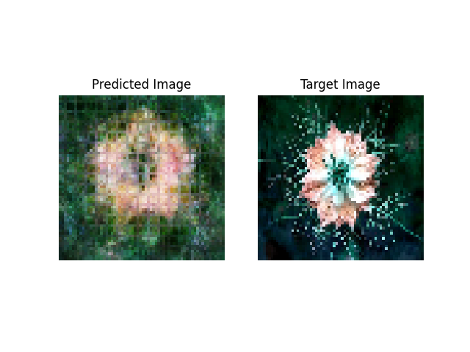
Qualitative Evaluation : Sample 1
Source Sentence :
this flower is orange and white in color, and has petals that are short and pointed.
there are many overlapping pale orange petals, with very prominent green stigmas in the center and many branching sepals around the petals.
a flower with white and orange petals and green anther filaments and pistils.

Slide 11
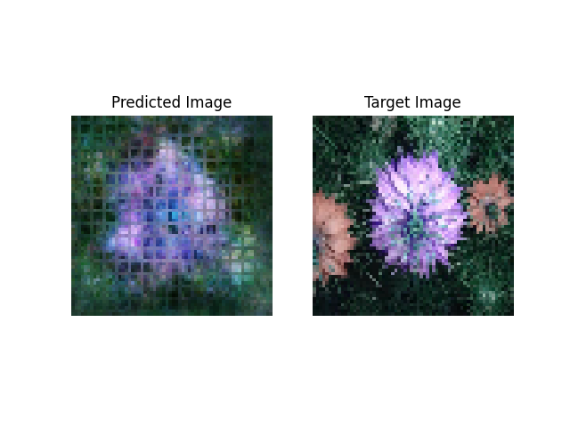
Qualitative Evaluation : Sample 2
Source Sentence :
petals are light purple in color with longer stamens and a prominent green pistil
this blue and purple flower has layered pointed petals and a dark green stigma.
this flower is purple and blue in color, with petals that are oval shaped.

Slide 12
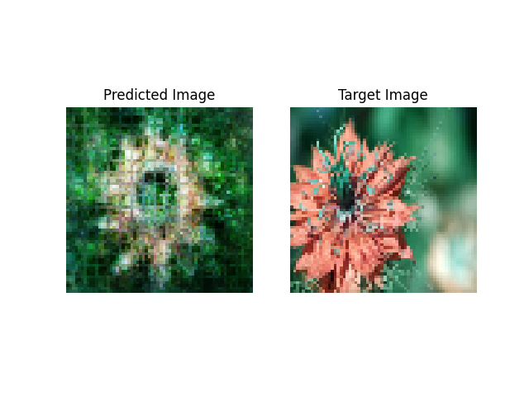
Qualitative Evaluation : Sample 3
Source Sentence :
this flower has orange and white petals, and several yellow anthers.
this flower has petals that are pink with green stamen
the petals of this flower are pink with a long stigma

Slide 13
References
Scott Reed, Zeynep Akata, Xinchen Yan, Lajanugen Logeswaran, Bernt Schiele, and Honglak Lee. 2016. Generative adversarial text to image synthesis. In Proceedings of the 33rd International Conference on International Conference on Machine Learning - Volume 48 (ICML'16). JMLR.org, 1060–1069.

